Slide 1
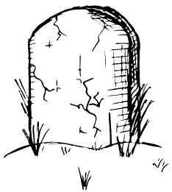
Living Threat Models Are Better Than Dead Threat Models
John S. Andersen, John L. Whiteman
Saturday, June 11, 2022

Slide 2
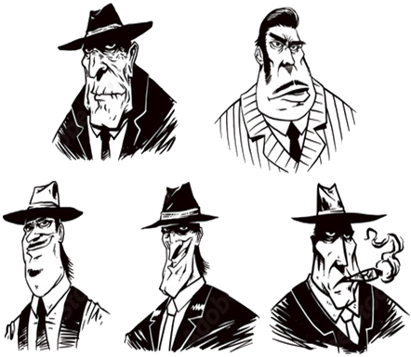
About This Presentation
STRIDE
P.A.S.T.A.
Assume that you know something about threat models (TM)
It's not about a particular TM methodology
Agnostic to TM tools
Primary focus is the collection and definition of data for TM use
VAST
Trike
DREAD
Notes:
https://as1.ftcdn.net/jpg/00/96/05/42/500_F_96054205_ucJJxEyNwrbvdeB5CqI7DOMCmObDJGU4.jpg

Slide 3

About John S. Andersen
Infrastructure and DevOps Architect - Intel Corporation
Passion for exploration and understanding
Analyzes software development methodologies and technologies to identify and proliferate best practice
Excited to explore the application of these techniques on human and AI agents.
Mission is to help foster an environment which maintains agent freedom, privacy, and security
Notes:
https://www.linkedin.com/in/john-andersen-7a72b555/

Slide 4

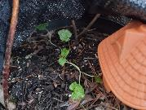
About John L. Whiteman
Security Researcher - Intel Corporation
PT Adjunct Instructor - University of Portland, UC Berkeley's Extension Cybersecurity Bootcamp
MSCS Georgia Tech, BSCS Portland State University, BA Asian Studies University of Maryland Global Campus, CISSP, CSSP,
U.S. Navy Veteran, FCC (KG7VKB)
Micro Wasabi Grower and Kombucha Maker
Notes:
https://www.youtube.com/watch?v=7dZYHRmYFeo
https://www.youtube.com/watch?v=D9puJiKKKS8

Slide 5

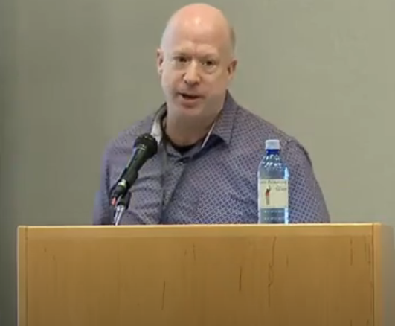
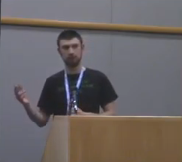
About John²
[JSA/JLW]: Both worked as security researchers for Intel Open Source Technology Center (OTC) (~2016)
[JLW/OHSU]: SAST and the Bad Human Project (2018)
Used machine learning to predict risk across hundreds of web applications without SAST
[JSA/Intel]: Down the Dependency Rabbit Hole (2019)
Used machine learning to assess risk across thousands of third-party, open-source projects to help teams to determine if adoption is viable
Fundamentally, we were trying to solve the same problem.
Notes:
https://www.youtube.com/watch?v=7dZYHRmYFeo
https://www.youtube.com/watch?v=D9puJiKKKS8

Slide 6
Living Threat Models (LTM)
dynamically
Find ways to assess risks associated with projects
Collect lots of data from git repos and other sources
Define a standardized risk-specific language to use for threat modeling
Integrate these systems into CI/CD frameworks
Promote and socialize our efforts for industry-wide adoption
Retire

Slide 7
When Apps Evolve, So Does the Risk And So Should the Threat Model

Slide 8
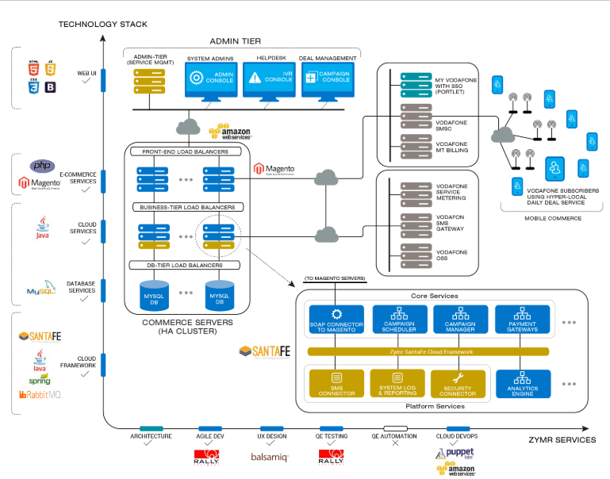

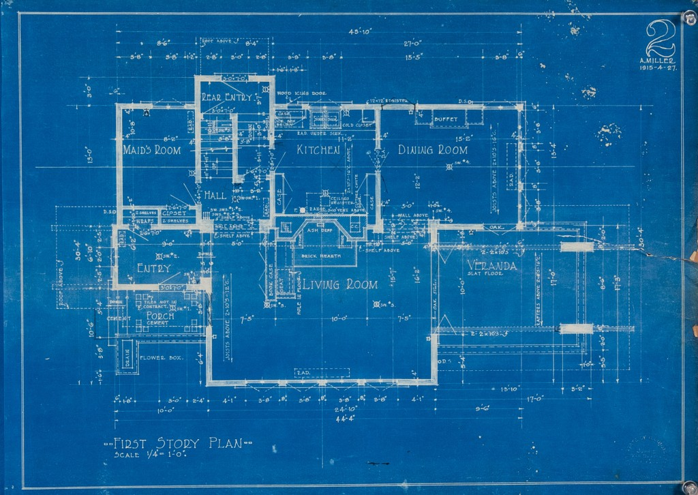



Typical TM Workflow
Architecture Design
Tombstone Threat Model Process (TTMP)
Manual code review
Static source code scanning (SAST)
Dynamic testing (fuzzing) (DAST)
Commit some code
Find and fix vulnerabilities
Init
Threat Model
TM
Release
Storage
Notes:
Best Before sounds Better than Expiration Date
http://www.artit-k.com/dev-basic-oop/blueprint/
This Photo by Unknown Author is licensed under CC BY-SA-NC
https://github.com/logos
https://www.shrosystems.com/images/data_centre_cloud_1.jpg
https://epthinktank.eu/2015/02/16/best-before-date-labels-protecting-consumers-and-limiting-food-waste/

Slide 9
All Threat Models Should Be Machine Readable

Slide 10

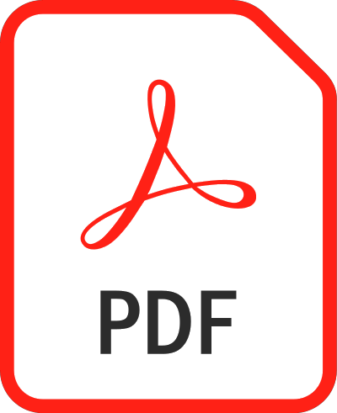




Typical TM Storage
TM
Application Specific Languages (ASL)
PowerPoint
Word
Visio
PDF
GIMP
Draw.io
Notes:
https://commons.wikimedia.org/wiki/File:Microsoft_Office_PowerPoint_(2019%E2%80%93present).svg
https://commons.wikimedia.org/wiki/File:Microsoft_Office_Visio_(2019).svg
https://commons.wikimedia.org/wiki/File:Microsoft_Office_Word_(2019%E2%80%93present).svg
https://en.wikipedia.org/wiki/File:PDF_file_icon.svg
https://commons.wikimedia.org/wiki/File:JPEG_format_logo.svg
https://commons.wikimedia.org/wiki/File:The_GIMP_icon_-_gnome.svg

Slide 11
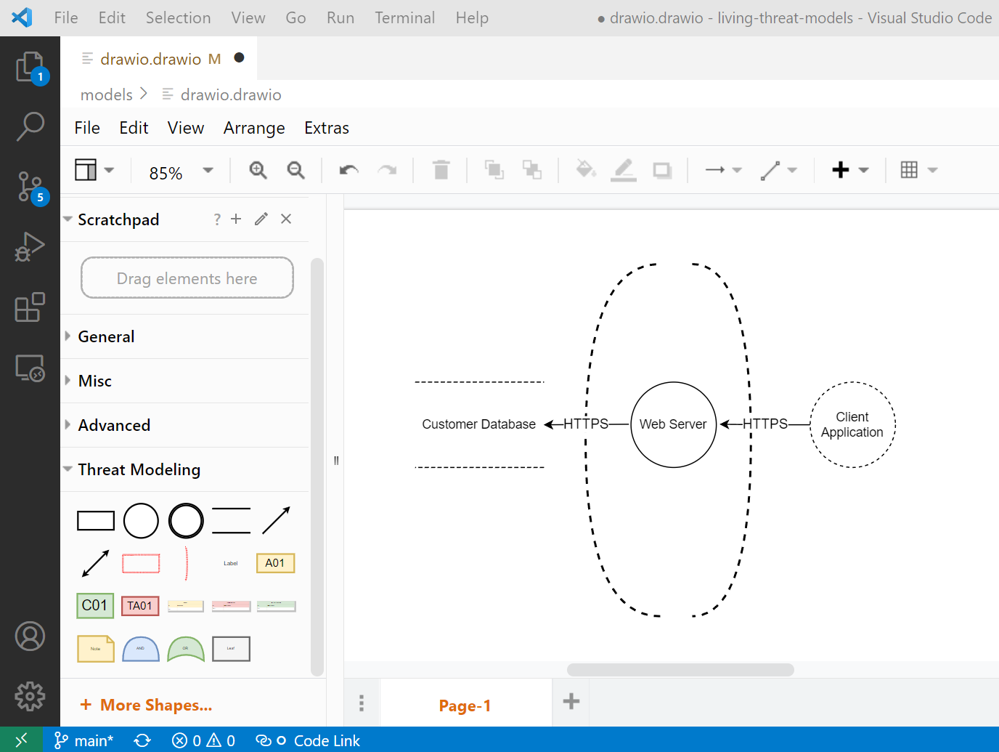
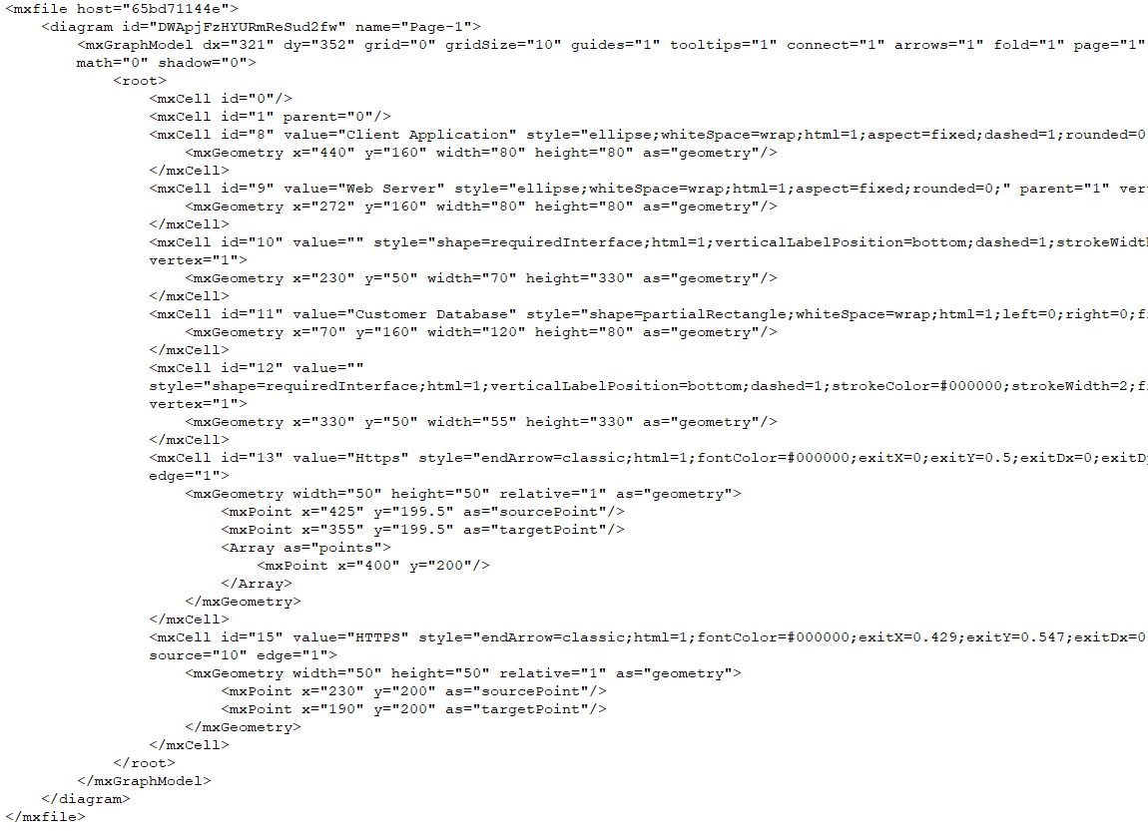
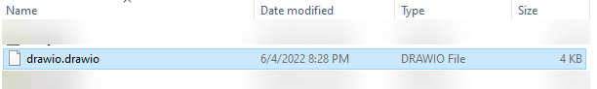
Draw.io - ASL Data Example
Uses a general purpose language (GPL) - XML
Machine readable, text-based, small footprint
Mixed data with irrelevant presentation logic
Not designed with security in mind

Slide 12
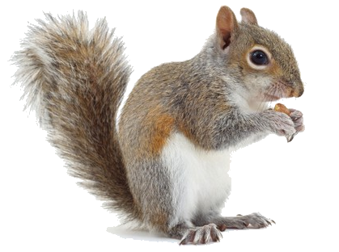
TM Tools Are Dangerously Shiny Objects
Notes:
https://images.immediate.co.uk/production/volatile/sites/22/2018/09/greysquirrelid-2ea8807.jpg?background=white&lb=620,413&quality=90

Slide 13
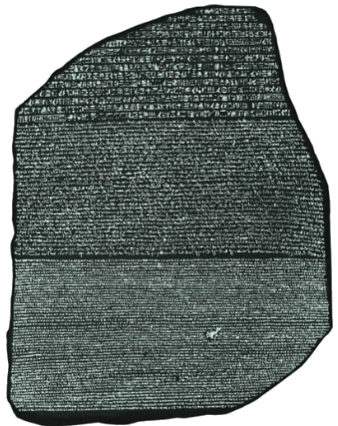
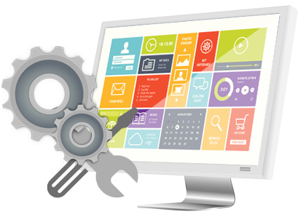

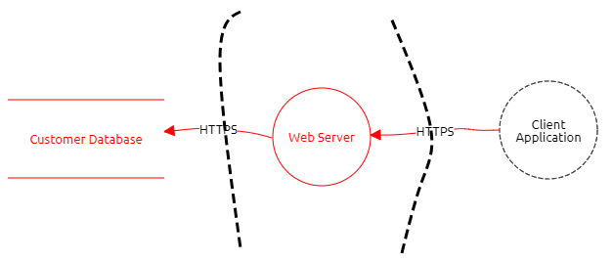
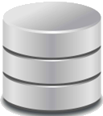
Fun to Make, Fun to Use
Diagramming, APIs, Reports, Templates, Stencils, Gamification
App 1
TM Tool
ASL
App 2
But most of the tools are not CI/CD friendly
And it's not because they don't have the features to automate
It's the lack of a well-defined, TM language that makes it less appealing to adopt
Teams must build their own ASL translators to talk amongst other applications
It's hard enough to get teams to do security in the first place
Notes:
https://innovecs.com/wp-content/uploads/2020/11/building-software-development-teams.jpg
https://www.calendarpedia.com/images-large/three-year/calendar-2023-2024-2025.png
https://www.pngall.com/wp-content/uploads/2016/07/Software-Development-PNG-Image.png
https://chartattack.com/wp-content/uploads/2020/01/Team.jpg
https://cdn.careeronestop.org/OccVids/OccupationVideos/15-1199.01.jpg
https://cdn.careeronestop.org/OccVids/OccupationVideos/15-1199.01.jpg

Slide 14



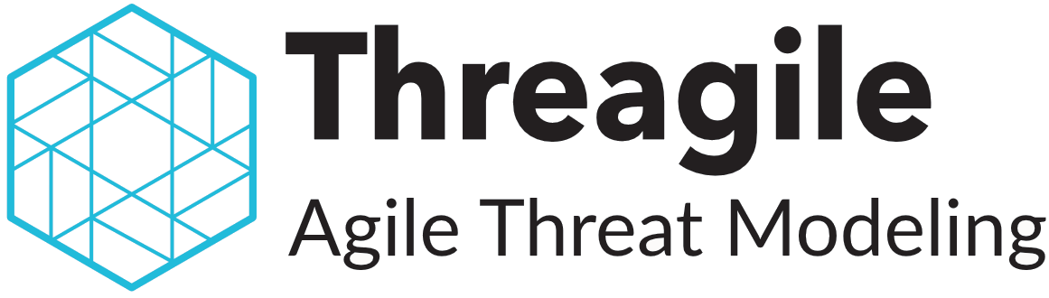

Threat Model Tools and Data Formats
Name | Type | ASL Format | Export Formats | Logo
CAIRIS | Open Source | XML | DOCX/ODT/RTF
Microsoft Threat Modeling Tool | Free (Proprietary) | XML | CSV, HTML
OWASP Threat Dragon | Open Source | JSON | PDF
Threagile | Open Source | YAML | Excel/JSON/PDF
Threat Modeler | Proprietary | XML | Excel/PDF
Two kinds of data format contexts - ASL, exported reports
Like to see GPLs used for both
Notes:
https://www.threatdragon.com/
https://owasp.org/www-project-threat-dragon/
https://docs.microsoft.com/en-us/azure/security/develop/threat-modeling-tool
https://cairis.org/
https://threatmodeler.com/
https://tm-awsmp.s3.amazonaws.com/ThreatModeler%2BInterface%2BGuide.pdf
https://threagile.io/

Slide 15
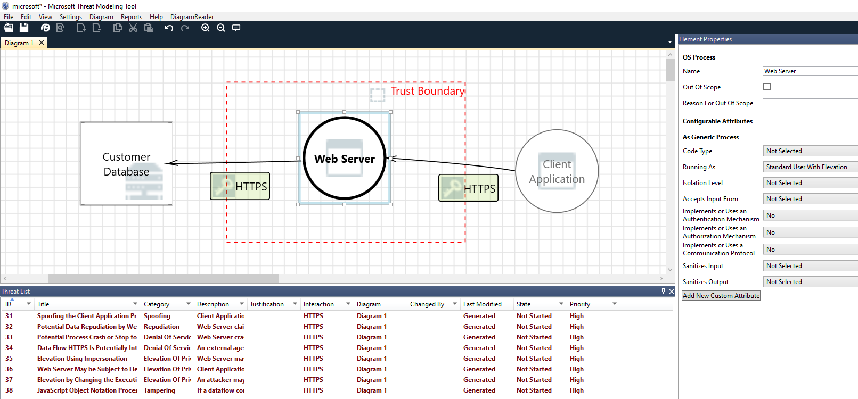
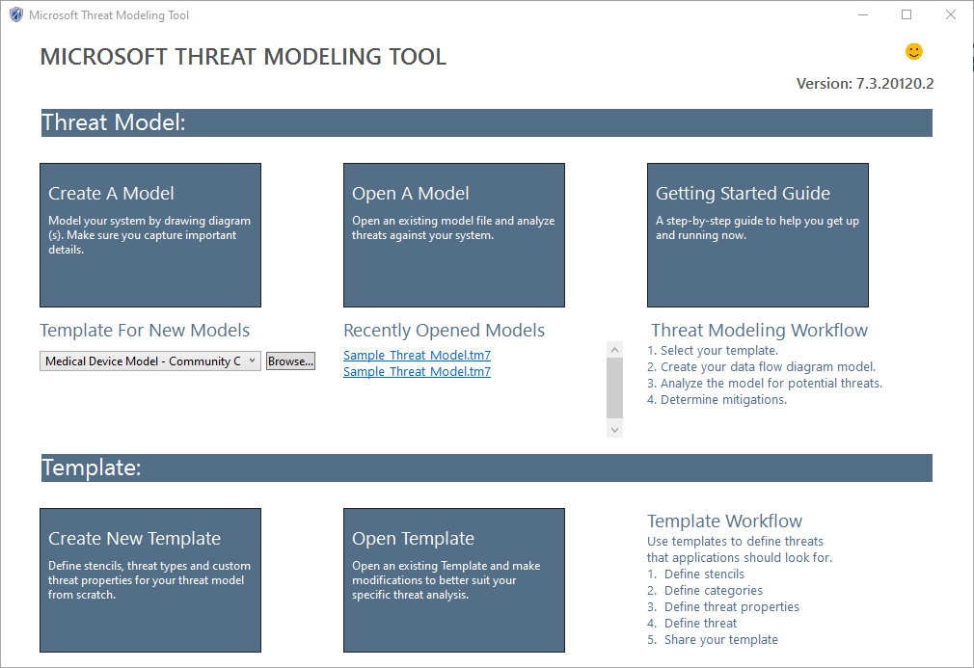
MS Threat Modeling Tool - Example
Notes:
ttps://docs.microsoft.com/en-us/azure/security/develop/threat-modeling-tool
Stencils

Slide 16
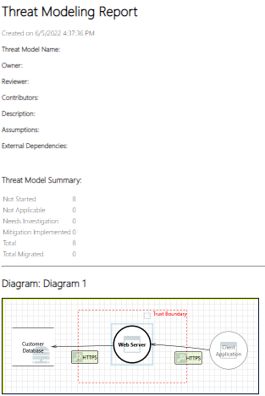
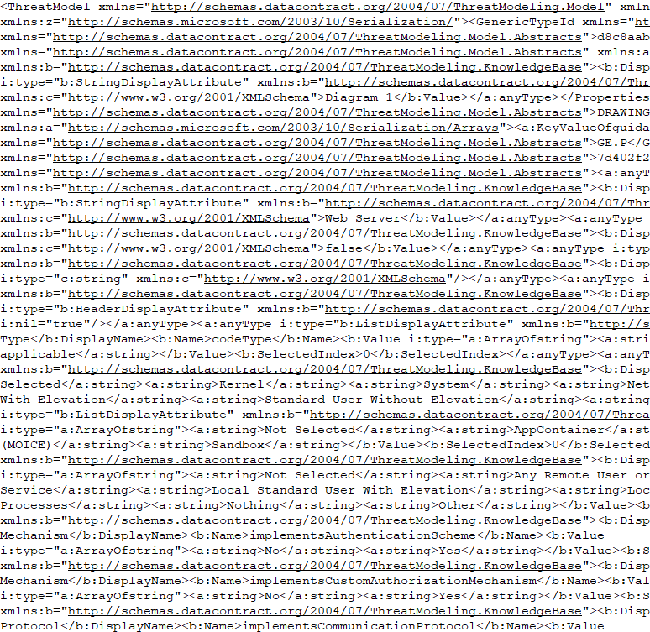
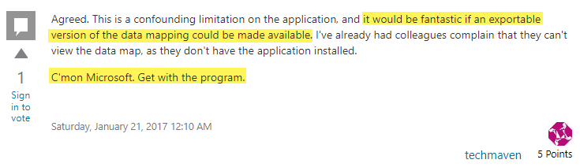
MS Threat Modeling Tool - Example
microsoft.html
microsoft.tm7 (ASL)
Observations
Nice tool but data exchange is not ideal
.tm7 is ponderously parsable
GUI only
Not CI/CD friendly
Export report to html
Extract embedded image from html
Notes:
https://social.msdn.microsoft.com/Forums/en-US/96cf65be-2e81-40a5-bc4a-de4f8ca4e31b/threat-modeling-tool-2016-export-tm7-to-pdf-or-visio?forum=sdlprocess

Slide 17
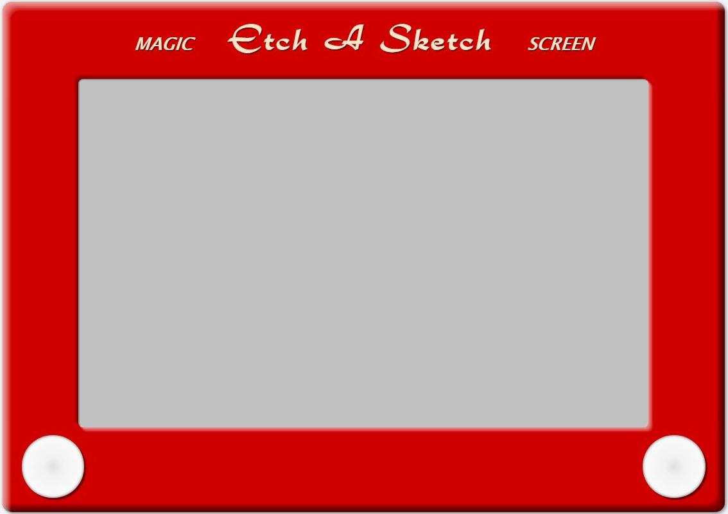
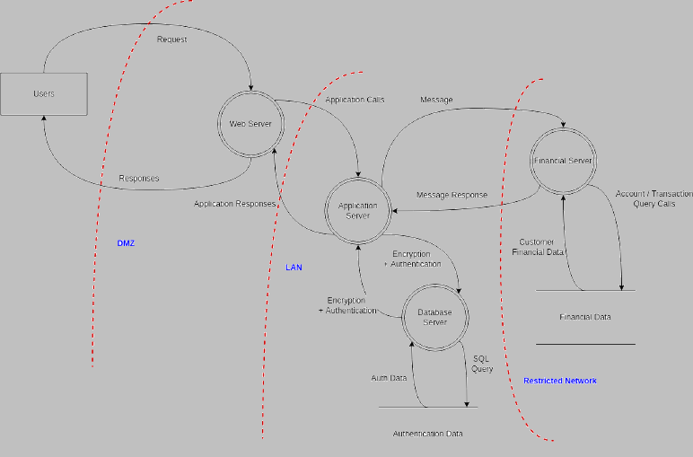
BTW - Our Favorite TM Tool
Notes:
https://724681b3-a-62cb3a1a-s-sites.googlegroups.com/site/ateachersbagoftricks/classroom-news/onlineetch-a-sketch/etch.JPG?attachauth=ANoY7cpvMftRfyiyRNDYERiOsktK5XBUxv4Y-TDgWIbIgU35rJoGMNwVL6OHnF6luyLOi3ntgLvzT5MFyWl66EsPdMUhgLzBe-hgkmwcPtuJoRYpmfJvjVgZigAFtS4X8dGfeq4GwvrYmk9UdqERX4rHbaJ440KV9fnJyefQTqBmr1p8iN-jFlrn7ndx1F8hINTJ1QCKrryKYqBoplZ9wYVpU7L3gEaWo5FifIKbqLluhSWM4NAZ42zxaBP590rNIjv7oCi5Dd6AtGLavK59P9ViwGKypY5sDg%3D%3D&attredirects=0
https://online.visual-paradigm.com/diagrams/templates/threat-model-diagram/website-threat-modeling/
https://as1.ftcdn.net/jpg/00/96/05/42/500_F_96054205_ucJJxEyNwrbvdeB5CqI7DOMCmObDJGU4.jpg
https://www.apiaviation.com/wp-content/uploads/2016/02/job-interview-be-prepared-A-1.jpg

Slide 18
More About Data Languages
Application Specific Languages (ASL)
Machine readable
Super specialized
Mixed content
Not portable, heavy
Applications
General Purpose Languages (GPL)
Machine readable
Generalized
Widely known/accepted
Portable, lightweight
JSON, XML, YAML
Domain Specific Languages (DSL)
Machine readable
Specialized
Idiomatic to domain
Compact, lightweight
HTML, Mermaid, PlantUML, SQL
Notes:
Syntax highlighting
Multiple formats

Slide 19
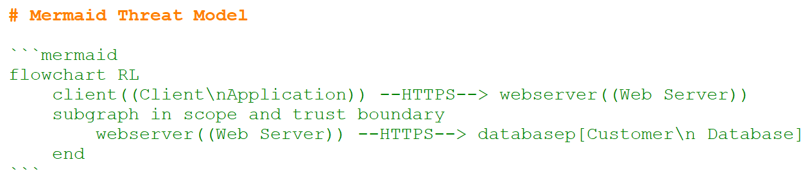
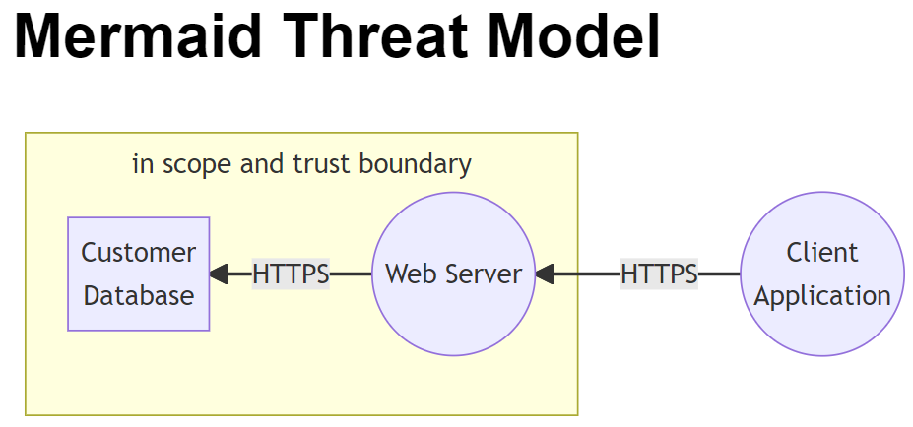
Mermaid - DSL Example 1
mermaid.md

Slide 20
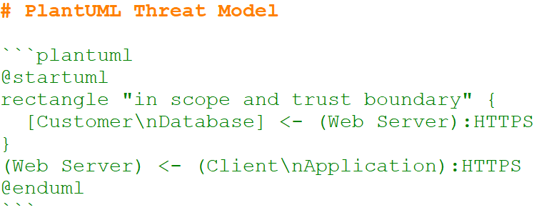
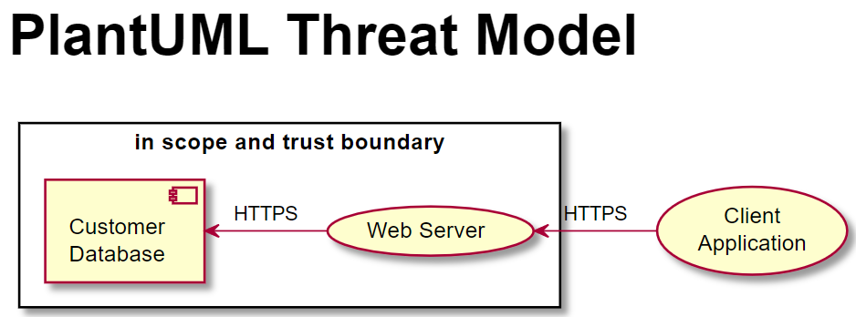
PlantUML - DSL Example 2
plantuml.md

Slide 21
Define a Standardized TM Language
TM Standard is the definition of the language approved by a recognized standards organization, e.g., ISO
TM DSL is an implementation of the standard that uses a GPL to do it, e.g., JSON, XML, YAML
Avoid specialized syntax, like Mermaid and PlantUML
Folks builds apps that parse and present it ... VS Code plugin, GitHub, Markdown editors, ...
GPL
TM DSL
TM Standard

Slide 22
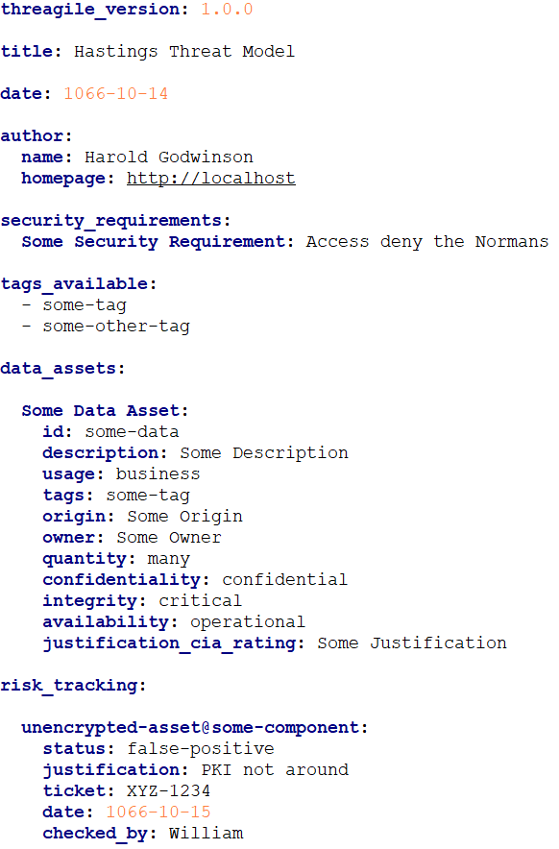
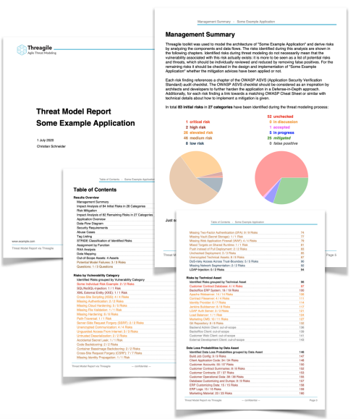
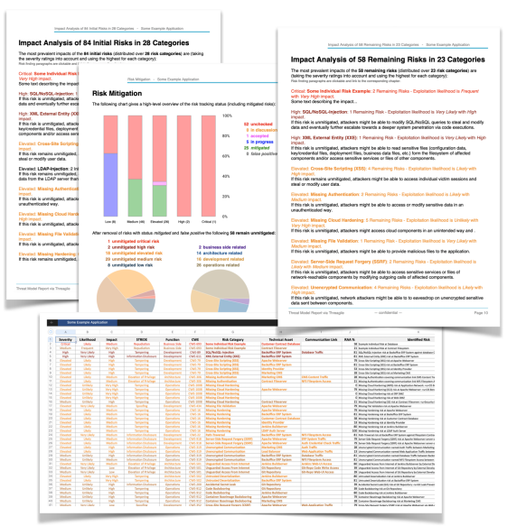
Threagile - Example
threagile.yaml
Open source tool that already does this
Not a standardize language though
Uses GPL YAML to define a TM DSL
Assets, flows, trust boundaries
Stores nicely in the repo as text
Command line tool (threagile) (go) ingests the YAML file to generate reports, audits
Notes:
https://www.youtube.com/watch?v=5n-8LqHMoJ0
https://github.com/Threagile/threagile/blob/master/demo/example/threagile.yaml
https://threagile.io/
https://github.com/threagile
https://deepsec.net/docs/Slides/2020/How_To_Combat_Risks_Directly_From_Within_Your_IDE_Christian_Schneider.pdf

Slide 23
Scan Threat Models Like You Scan Code

Slide 24
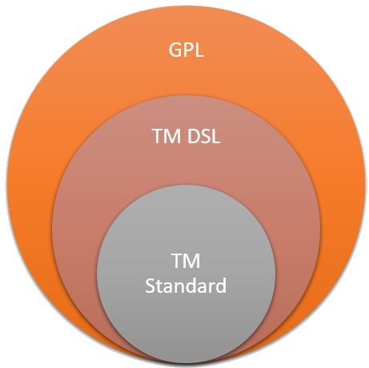
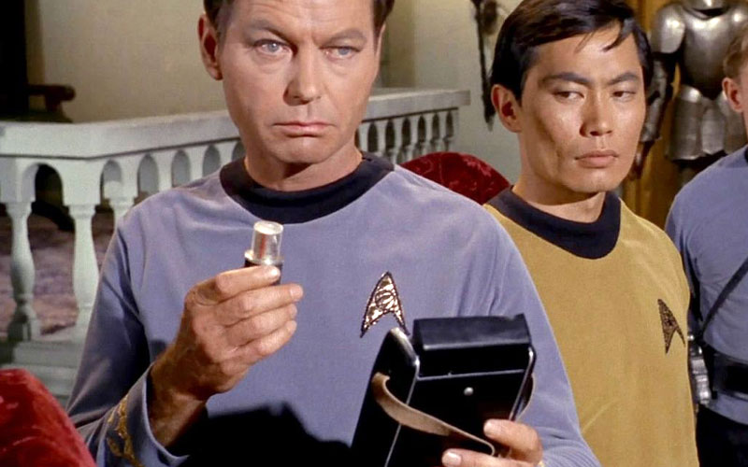
CI/CD TM Automated Scans
Now that we have our TM DSL let's do:
Quality Checks (Linter)
Missing assets, labels, ...
Duplicate names
Age (Best Used Before Date)
Vulnerability Checks (SAST)
Lack of or incorrect mitigations
Discrepancies between TM and source code
e.g., source code contains networking libraries but the TM says nothing about using networks
Notes:
https://treknews.net/wp-content/uploads/2017/03/bones-mccoy-medical-tricorder.jpg

Slide 25

OWASP Threat Dragon
Let's use our very own Threat Dragon to make our point!
Open source threat model application
Goodwin/Gadsden/Reading et al.
Standalone and web-based versions
Latter nicely integrates into GitHub (OAuth?)
TMs are machine readable (sort of)
ASL -> JSON, Exports -> PDF
Notes:
https://github.com/OWASP/threat-dragon
https://www.threatdragon.com/
https://owasp.org/www-project-threat-dragon/

Slide 26
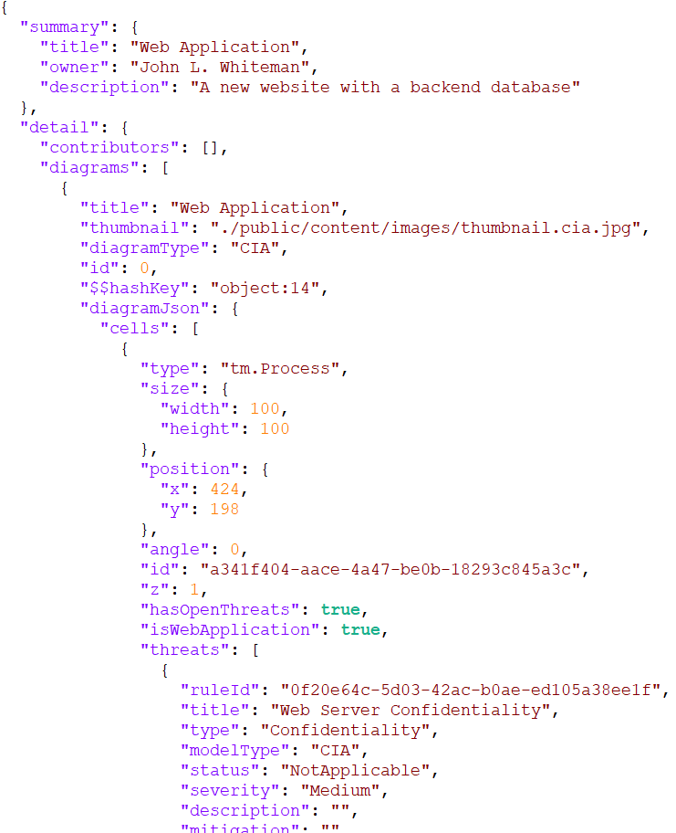
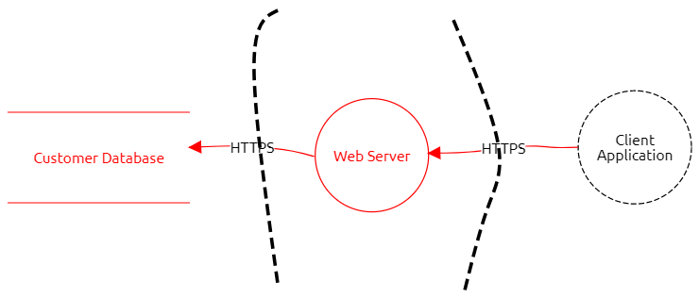
Threat Dragon TM
ASL Data
GPL

Slide 27
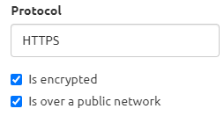
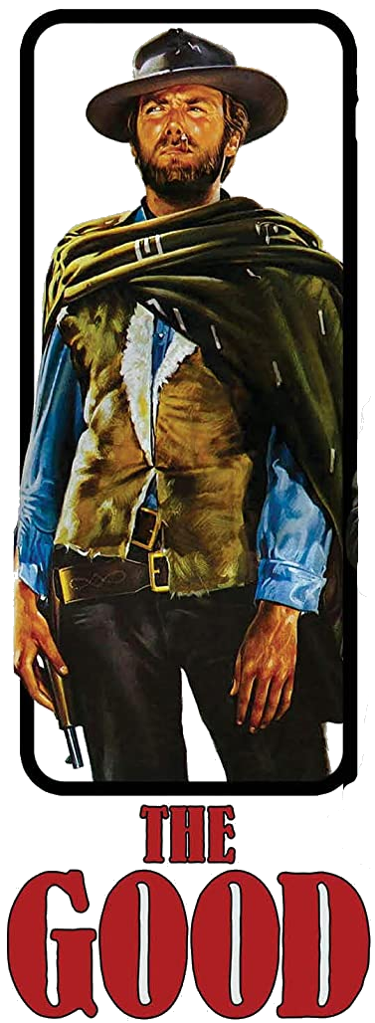
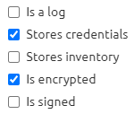
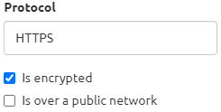
Threat Dragon TM (Good)
good.json
Notes:
https://www.amazon.com/Good-Bad-Ugly-Anniversary-Single/dp/B07MS59ZL6

Slide 28
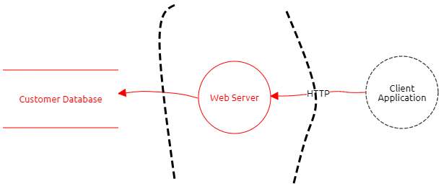
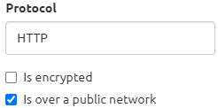

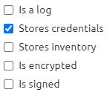
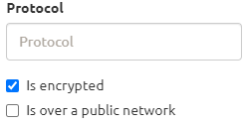
Threat Dragon TM (Bad)
An Intentionally Vulnerable Threat Model!
bad.json
Notes:
https://www.amazon.com/Good-Bad-Ugly-Anniversary-Single/dp/B07MS59ZL6

Slide 29


Threat Dragon TM (Ugly)
What is an ugly threat model?
No threat model ...
∅
... at all!
ugly.json
Notes:
https://www.amazon.com/Good-Bad-Ugly-Anniversary-Single/dp/B07MS59ZL6

Slide 30
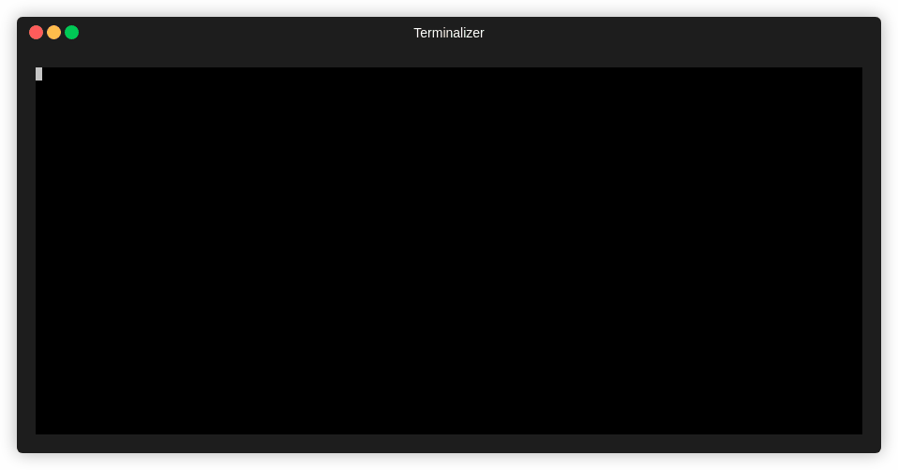
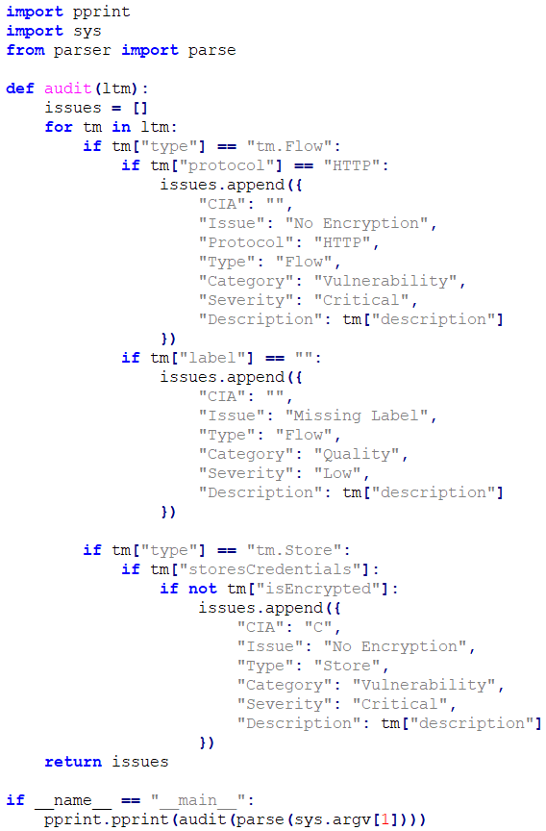
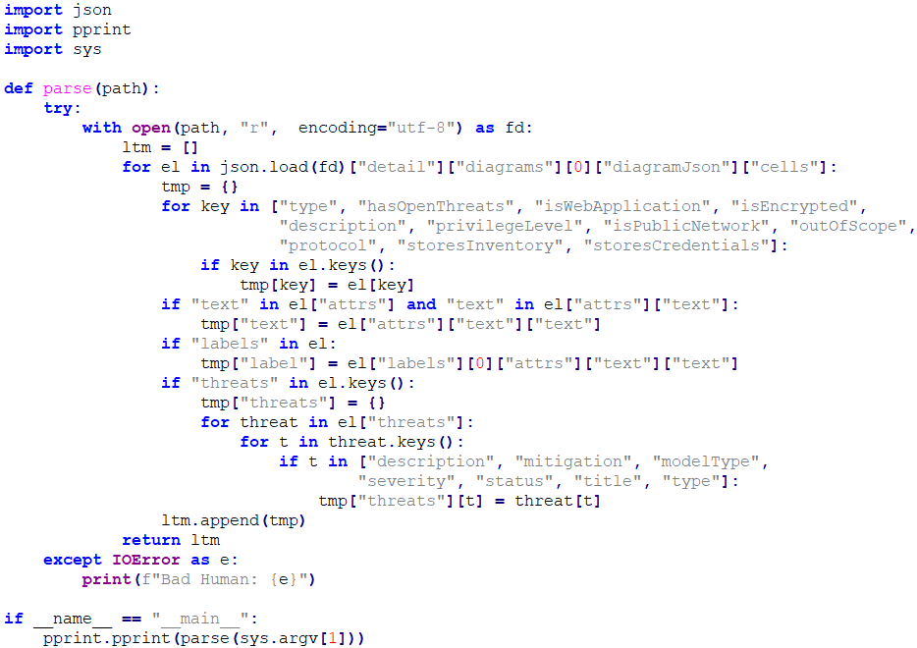
Threat Dragon TM Scanner Demo
parser.py
auditor.py

Slide 31
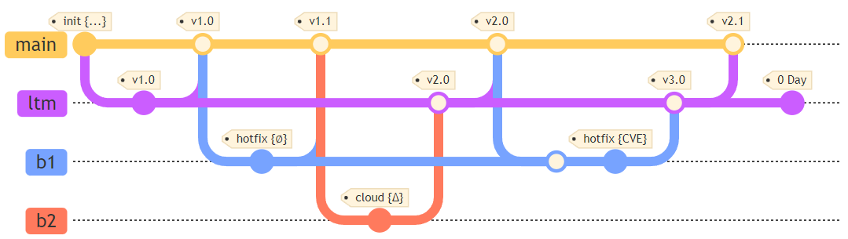
A Git Workflow - LTM as a Branch
Initial check-in includes the threat model (chicken, egg, threat model)
Code changes that don't affect LTM are merged directly to main {∅}
Code changes that affect the LTM are first merged to ltm branch {Δ}
LTM changes, e.g., 0 Day Vulnerabilities, can precede code changes
Notes:
What comes first, chicken, egg or threat model

Slide 32
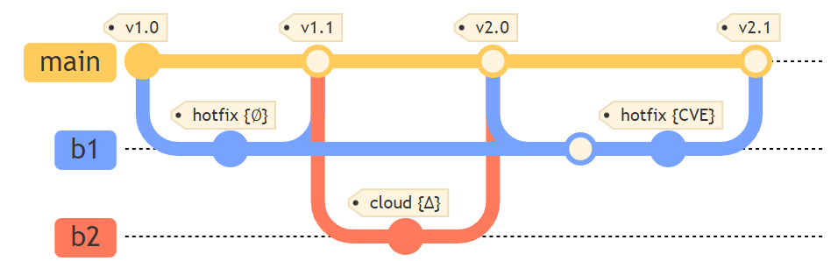
Another Git Workflow - LTM Included
Initial check-in includes the threat model like before
LTM is included as part of the regular check-ins on same branch
Less maintenance and possibly easier to automate
Teams should still threat model before, during and after

Slide 33
Treat Threat Models Like Source Code
Notes:
Why do we not see more threat models in git repositories

Slide 34
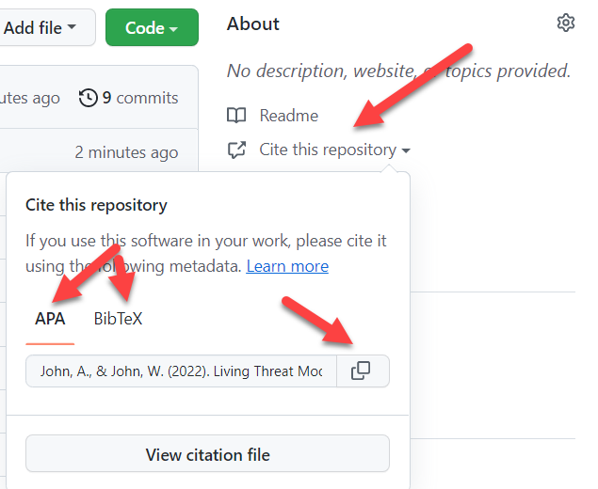
Overlays - ADD STRIDE/DREAD/ETC (TODO)
Notes:
Syntax highlighting
Multiple formats

Slide 35
Threat Model Workflow
Notes:
Why do we not see more threat models in git repositories

Slide 36

DFFML Demo
https://intel.github.io/dffml
https://github.com/intel/dffml
Notes:
https://github.com/intel/dffml
https://intel.github.io/dffml/

Slide 37
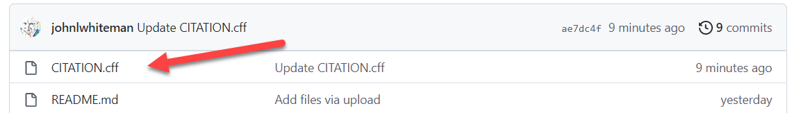

Context Example - CITATION.cff
[BibTex] @software{John_Living_Threat_Models_2022,
author = {John, Andersen and John, Whiteman},
month = {6},
title = {{Living Threat Models}},
url = {https://github.com/johnlwhiteman/living-threat-models},
version = {1.0.0},
year = {2022}}
[APA] John, A., & John, W. (2022). Living Threat Models (Version 1.0.0) [Computer software]. https://github.com/johnlwhiteman/living-threat-models
Notes:
Syntax highlighting
Multiple formats

Slide 38

Things That We Think Need Attention
Four Observations
Lack of a lightweight, domain-specific language for threat modeling.
Most project teams are not even threat modeling.
And, if they do, where in the projects' repos are the threat models stored, if at all?
And, if there are threat models, are they up-to-date with the latest, applicable changes?
Notes:
https://thenounproject.com/icon/four-fingers-4230415/

Slide 39

Where Are the Threat Models?
Most open-source projects don't provide threat models
Does this mean that they are not threat modeling?
Not sure ... some probably are ... but most not
And for those that do threat model
How and where are they stored?
And for those that don't threat model
Keeping you head in the sand gives us an easy target to kick
Notes:
https://henrykotula.com/2020/12/07/cartoon-crisis-what-crisis/
https://cruciality.files.wordpress.com/2014/03/bury-head-in-sand.jpg?w=620

Slide 40
Treat Threat Models Like Source Code
Notes:
Why do we not see more threat models in git repositories

Slide 41





Meta Attack Language (MAL)
DSL to create threat modeling and attack simulations for any domain you want ...
Automotive, Cloud, SCADA, Web
Language captures assets, relationships among them and attackers
Formalized syntax specifications, templates
Open Source Research (Sweden)
Community driven
Some commercial adopters
https://mal-lang.org/
https://github.com/mal-lang
Notes:
https://link.springer.com/chapter/10.1007/978-3-031-07475-2_10
https://mal-lang.org/
https://github.com/mal-lang

Slide 42
It All Starts with the REPO
You want to write a book? What are the best tools out there?
MS Word, Google Docs, Scrivener, Abode, Evernote, Freedom, Hemingway, Vellum, Notepad, VI/VIM(!Emacs), yWriter, ...
BTW: Distraction free editors - (Idiocracy marketing speak for editors without features but come at a higher price tag)
You want to threat model? What are the best tools out there?
OWASP Threat Dragon, Microsoft Threat Modeling Tool, SecuriCAD, Threagile, Tutamen, Threatmodeler, Draw.io, Visio, ...
Notes:
Talk about writing a book
I did not put EMACS because that is an Operating System
Distraction Free - An Editor without any features

Slide 43
THREATS.md Is the LTM's README.md
Assets

Slide 44

Lesson Learned
"Remember that having a threat model is still better than a kick in the head."
Notes:
https://thenounproject.com/icon/standing-ovation-969109/

Slide 45
References
Andersen, J. S. (2022). DFFML. GitHub. Retrieved June 06, 2022, from https://github.com/intel/dffml
Hysn Technologies. (2020). Awesome Threat Modeling. GitHub. Retrieved June 5, 2022, from https://github.com/hysnsec/awesome-threat-modelling
Whiteman, J. L. (2022). Living Threat Models. GitHub. Retrieved May 31, 2022, from https://github.com/johnlwhiteman/living-threat-models

Slide 46
Thank You!

